Slide 1


Titolo presentazione sottotitolo
Concert Ticket Service – Project Type C
Simone Scevaroli - 10913296
Performance Evaluation and Applications Project 2023 - 2024
Milano, XX mese 20XX

Slide 2
Project Statement

Slide 3
Project Statement
A concert ticketing service has to handle a large number of requests in a short amount of time
The system can allow at most N = 1000 pending requests at a time
The service is composed by four stages:
Welcome message (W)
Seat Selection (S)
Payment processor (P)
Ticket issuing (T)
Simone Scevaroli

Slide 4
Goals of the Project

Slide 5
Goals
Average response time below 5 minutes
Average drop probability below 25%
using the fewest possible cores per stage
Simone Scevaroli

Slide 6
Solution

Slide 7
Fitting
First of all, it was necessary to fit the given traces (using MATLAB), determing which distribution and parameters best follows the curve of durations for each stage
To obtain all the parameters for the distributions in minutes, the durations of the traces were divided by 60*1000 (since they were in milliseconds)
All the plots are commented in the MATLAB file. If you wish to view the plots, you need to remove the «/60000» initially added to the dataset and uncomment the desired plot
Simone Scevaroli

Slide 8
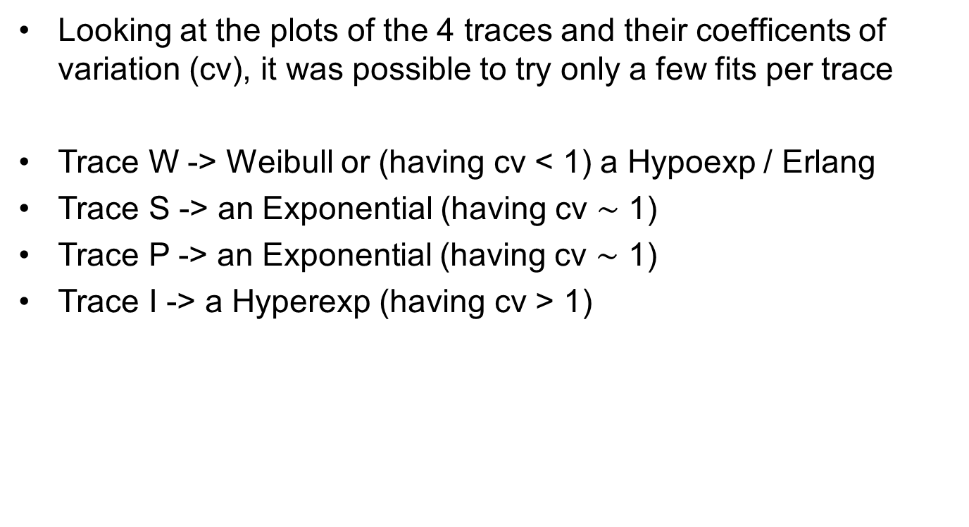
Fitting
Looking at the plots of the 4 traces and their coefficents of variation (cv), it was possible to try only a few fits per trace
Trace W -> Weibull or (having cv < 1) a Hypoexp / Erlang
Trace S -> an Exponential (having cv $\sim$ 1)
Trace P -> an Exponential (having cv $\sim$ 1)
Trace I -> a Hyperexp (having cv > 1)
Simone Scevaroli

Slide 9
Fitting
The following results were found:
Trace W -> Erlang distribution Params -> k=36, λ=288008 min⁻¹
Trace S -> Exponential distribution Params -> λ=239.124 min⁻¹
Trace P -> Exponential distribution Params -> λ=1203.19 min⁻¹
Trace I -> HyperExp distribution Params -> λ₁=537.042 min⁻¹, λ₂=2149.71 min⁻¹, p₁=0.203235
Simone Scevaroli

Slide 10
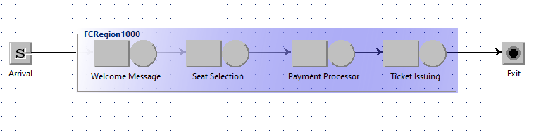
Simulation using JMT
After identifying all the necessary parameters, I used JMT to implement the following queuing network, representing the topology of the system
Simone Scevaroli

Slide 11
Simulation using JMT
The system shown before is characterized by:
An open class, modeled as a Markov-Modulated Poisson Process (mmpp2) with λ₀=6000 req/min, λ₁=300 req/min, σ₀=1/480min and σ₁=1/9600min. It represents the arrivals
Four queue stations, each representing a stage of the system and modeled based on the distribution and parameters found during the fitting process
A finite capacity region, with a size of 1000. This ensures that no more than 1000 requests are present in the system at any given time
Simone Scevaroli

Slide 12
Performance indexes
The following indexes were computed at each iteration to understand how to modify the systems, adding cores to stages when necessary:
Utilization (for all stages)
Source Throughput
System Response Time
System Drop Rate (Number of drops)
System Drop Percentage (SysDropRate/SysThroughput)
Simone Scevaroli

Slide 13
Other JMT parameters
For each simulation I used the following JMT parameters:
Maximum number of samples -> 10M
Confidence interval -> 0.99
Maximum relative error -> 0.03
Simone Scevaroli

Slide 14
Running simulations
All the results from my simulations were put into an Excel file, documenting important values for each simulation
The Excel file is inside the folder so you can have a look at all the iterations and the results obtained
In particular, to determine the allocation of cores for the next run, I identified bottlenecks by looking at the utilizitation of each stage: if the average utilization was close to 1, I increased the number of cores for the corresponding stage
Simone Scevaroli

Slide 15
Results

Slide 16
Results
Through multiple iterations of this process, I discovered that:
The average response time was already below 5 minutes even with just 1 core per stage. However, the drop rate percentage exceeded 95%, which is unaccetable for a concert ticket service
It took 11 iterations to reach the final configuration that minimized the number of core per stage, achieving both an average response time and an average drop rate percentage below the given threshold
Simone Scevaroli

Slide 17
Results
The final configuration found is:
1 core for Welcome Message stage
19 cores for Seat Selection stage
4 cores for Payment processor stage
4 cores for Ticket Issuing stage
Simone Scevaroli

Slide 18
Conclusions

Slide 19
Conclusions
It’s important to note that, with the discovered configuration, the drop rate percentage is just slightly below 25%. If additional resources (in terms of cores/money) are available, it’s better to increase the number of cores in the Seat Selection stage (the last bottleneck) by at least one. This adjustment aims to further reduce the drop rate percentage, ensuring a more secure and stable outcome
It was clear after the fitting phase that the Seat Selection stage would frequently be the bottleneck and would require the highest number of cores, because its exponential distribution has a very low lambda compared to the other exponentials, indicating a lower number of requests processed per minute
Simone Scevaroli

